Slide 1
AUTONOMOUS MOBILITY RESEARCH
Autonomous Driving
Sentiment Monitor
Exploring YouTube discussion with sentiment analysis
Luuk & Nina
15 October 2026
01
Notes:
Autonomous Driving Sentiment Monitor. Luuk Aalders. Research prototype connecting YouTube data collection, Hugging Face inference and a live dashboard. Sources: project README.md and EVALUATION_REPORT.md.

Slide 2
Research question and purpose
How does sentiment toward self-driving cars change
in the selected YouTube discussions?
Observed problem: approval of damage to a vehicle was labelled Positive,
while the human annotator judged its attitude to autonomous driving Negative.
SDG 9: examining concerns about transport innovation
Researchers need traceable evidence before interpreting apparent acceptance.
The example comes from this project’s human evaluation; user interviews have not taken place.
02
Notes:
The research question concerns selected YouTube discussions, not representative population opinion. A manually annotated example approves damaging the vehicle; RoBERTa predicts Positive while the human target-specific label is Negative. This is observed evidence of an interpretation problem, not a claim of stakeholder validation. SDG 9 relevance: traceable investigation of concerns about autonomous mobility can inform exploratory research into innovation. No public-trust or infrastructure benefit has been measured. Sources: README.md, EVALUATION_REPORT.md, data/manual_labels.csv.

Slide 3
User group and intended use
Designed for
Outside the intended use
Mobility researchers
Explore attitudes and emerging concerns.
Individual drivers or passengers
Choosing whether a vehicle is safe.
Transport-policy analysts
Inspect evidence behind a trend.
General population opinion polling
Estimating what everyone thinks.
Autonomous-transport organisations
Review discussion around their technology.
Profiling individual commenters
Inferring personal traits or making decisions.
These are proposed users. Stakeholder testing has not yet taken place.
03
Notes:
Intended users, rather than people whose adoption has been tested: mobility researchers, transport-policy analysts and autonomous-transport organisations. They can explore sampled discussion and inspect source comments. The product is not designed for individual vehicle-safety decisions, population-wide opinion estimates or personal profiling. YouTube commenters are data contributors, not necessarily dashboard users. No stakeholder usability study has been conducted. Source: README.md.

Slide 4
YouTube data collection
01
Selected videos
First 20 unique IDs from the saved video list.
02
Official YouTube API
Up to 300 recent top-level comments per video each run.
03
Scheduled checks
GitHub Actions and cron-job.org, approximately every 10 minutes.
04
Persistent dataset
Unique comment IDs prevent repeated collection from adding duplicates.
Stored fields: comment ID, video ID, text, publication time and collection time
04
Notes:
The collector reads the first 20 unique video IDs from video_ids.csv and uses commentThreads.list, order=time, textFormat=plainText. It inspects at most three pages with 100 threads per page per video and stores the top-level comments only. The collection includes already existing recent comments. It skips known comment IDs and deduplicates the combined CSV. cron-job.org and the existing GitHub schedule trigger checks approximately every ten minutes. Source: https://github.com/LuukAalders/Hackathons/blob/main/Hackathon%206/collect_comments.py and https://developers.google.com/youtube/v3/docs/commentThreads/list

Slide 5
Sentiment analysis and automation
Hugging Face RoBERTa
Positive
Neutral
Negative
Python inference runs separately from the browser.
Each successful collection triggers a separate analysis workflow.
The local app retrieves completed results every 60 seconds.
Confidence is a model probability. Human labels measure sample accuracy.
05
Notes:
Model: cardiffnlp/twitter-roberta-base-sentiment-latest, exact revision 3216a57f2a0d9c45a2e6c20157c20c49fb4bf9c7. The model targets English social-media text. The project uses pretrained weights without training or fine-tuning. Hugging Face Transformers and PyTorch run in Python on CPU in GitHub Actions. Preprocessing normalises links/usernames, truncates to at most 512 tokens, validates labels and reports skipped records. The local script is incremental; the hosted artifact workflow currently reanalyses the dataset and caches model weights. Sources: https://huggingface.co/cardiffnlp/twitter-roberta-base-sentiment-latest; analyse_sentiment.py; sentiment/core.py; automation/sentiment.yml.

Slide 6
Why this approach fits the users
Manual reading
Provides context, but repeatedly reviewing thousands of comments is laborious.
Keyword counts
Find terms, but do not reliably distinguish praise, criticism and sarcasm.
Model + inspection
RoBERTa provides initial labels. Filters and source comments let researchers challenge the result.
Tested alternative
RoBERTa matched 32 of 51 human labels; VADER matched 17. Human review remains necessary.
Designed for exploratory research. Stakeholder time savings have not been measured.
06
Notes:
User fit: mobility researchers and transport-policy analysts need to locate patterns and inspect evidence rather than accept automated labels as final judgments. Manual reading retains context but is laborious at this dataset size; no empirical time-saving study has been performed. Keyword counts do not reliably resolve context. The implemented VADER baseline provides evidence about a simpler approach: on the same 51 relevant human annotations, RoBERTa matches 32 and VADER 17. One annotator and a small sample limit the comparison. Source: README.md and EVALUATION_REPORT.md.

Slide 7
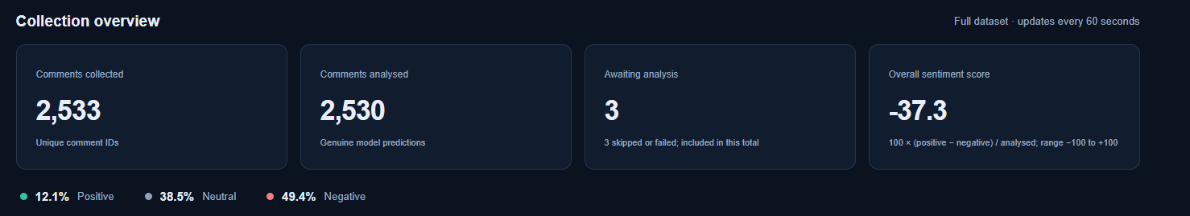
The working dashboard
2,533 unique comments
2,530 genuine model predictions
3 records remain explicitly unclassified
Accumulated dataset, including comments already available at collection start
07
Notes:
User-supplied screenshot of the collection overview, captured 15 October 2026. It shows 2,533 unique comments, 2,530 analysed comments, three unclassified comments and a score of -37.3. Counts include comments already available when collection started. The three unclassified records are one empty comment and two detected non-English comments in the verified snapshot. Predictions: 306 positive, 975 neutral, 1,249 negative. Percentages use 2,530 classified comments. Source: README.md, verified dataset snapshot and supplied image codex-clipboard-d1bf08d6-356e-4b30-a21b-f6621b248f60.png.

Slide 8
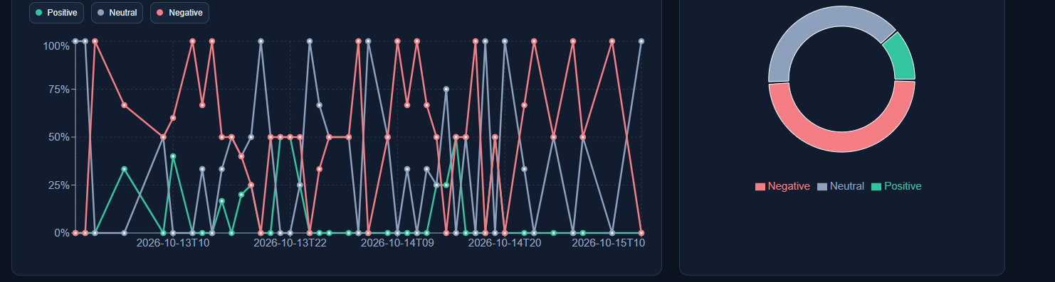
Interactive sentiment trends
Hourly sentiment
Distribution in selection
Filtered dashboard view
Date and sentiment filters determine which comments appear in the charts.
08
Notes:
The supplied screenshot shows a filtered dashboard selection, rather than the complete dataset. The screenshot header is cropped while keeping the complete plotted values, axes and distribution. The total dataset figures remain on the preceding slide. Hourly percentages use publication times. Small groups can produce sharp percentage swings. Source: supplied dashboard screenshot and README.md.

Slide 9
Model evaluation against human labels
51 relevant human labels
32 / 51
RoBERTa matches
17 / 51
VADER matches
60 annotations in total. Nine off-topic comments excluded. One annotator.
09
Notes:
Sixty real comments were annotated. Nine were not relevant and excluded, leaving 51 relevant comments, including 26 Negative, 17 Neutral and eight Positive. Both models were compared against the same human labels. RoBERTa matched 32/51 and VADER matched 17/51. The percentage chart shows agreement on this sample, not population-level verified accuracy. VADER version 3.3.2 uses compound thresholds of +/-0.05. Source: EVALUATION_REPORT.md and data/manual_labels.csv.

Slide 10
Where the model misinterprets meaning
Comment excerpt | Human | Model | Interpretation
“Technology gonna save us!!” | Neutral | Positive | Sarcasm changes the apparent praise.
“Hit it with your high intensity water hose” | Negative | Positive | Approval of damage targets the vehicle.
“Talk about a smart car...” | Negative | Positive | “Smart” mocks the vehicle’s behaviour.
General positive language can express a negative attitude toward the technology.
10
Notes:
All three examples are real comments, discussed by the human annotator. The model predicted Positive in each case. Human labels are Neutral for the sarcastic technology statement and Negative for the water-hose and smart-car comments. The hose explanation is that approval of damaging a vehicle expresses opposition to it. The smart-car comment mocks the vehicle. These examples illustrate target and contextual errors, rather than proof that every use of these words will fail. Source: EVALUATION_REPORT.md and data/failure_explanations.json.

Slide 11
Research limits and responsible use
Interpretation
Responsible operation
Selected videos and commenters
limit generalisation.
Traceable comment text requires
careful handling of personal details.
Small hourly groups amplify
changes in percentages.
Stored predictions remain separate
from original collected comments.
Sarcasm, language and topic
relevance can change the meaning.
Model caching reduces downloads.
Repeated full inference still uses compute.
The dashboard supports inspection. It cannot establish vehicle safety or public consensus.
11
Notes:
The selected videos and self-selected commenters are not a representative population sample. One person can contribute multiple comments. The collector covers top-level comments only and limits pagination. An English Twitter-trained model can fail on YouTube sarcasm, mixed languages or off-topic discussion. The collector does not store author-profile fields, but text and traceable IDs can contain personal information, so the dataset is not fully anonymous. Original inputs remain separate from predictions; failed refreshes retain a complete snapshot with a warning. Model caching reduces download costs, but full hosted reanalysis repeats inference. Sources: README.md, collector code and model card.

Slide 12
Ethical reflection
Privacy
Traceable text may expose commenters to unwanted attention. I omit author profiles, keep data private and limit shared excerpts.
Bias and exclusion
A selected English sample may overstate opposition. I disclose sampling limits; broader sampling is a next step.
Responsibility for errors
Wrong labels can mislead transport research. Source comments and human evaluation support review; a second annotator is needed.
Computational cost
Full reanalysis repeats computation. Weight caching reduces downloads; reusing validated predictions is a next step.
Automated labels support research. People remain responsible for their interpretation.
12
Notes:
Privacy: text and comment IDs remain traceable and could expose people to unwanted attention if redistributed. Author profiles are omitted and the repository is private; review excerpts for personal details before sharing. Bias: selected videos, self-selection and an English model exclude voices; researchers could mistake this sample for population opinion. Disclose limits, restrict conclusions and propose broader sampling. Misclassification: sarcasm and target attitudes can reverse interpretation and mislead analysts; source inspection and genuine human labels provide current checks, while independent annotation is proposed. Computation: repeated full hosted inference consumes extra resources; weight caching is implemented, incremental prediction reuse remains proposed. Sources: README.md and EVALUATION_REPORT.md. No anonymisation, representative sampling or measured energy savings is claimed.

Slide 13
Conclusions and next steps
A working pipeline makes
comments easier to explore
RoBERTa performs better than VADER on the labelled sample.
Its errors still make human inspection necessary.
Next steps
Broader sampling, independent annotators and relevance classification
Live demonstration: localhost:3101
13
Notes:
Live walkthrough: open localhost:3101 and show totals plus synchronization status. Select a date range and chart point; inspect the corresponding comments and a source-video link. Open /evaluation to compare the models with human annotations and explain an error. A refresh retrieves completed data; it does not start collection. These are demonstration instructions, not a claim that a recording is included. Sources: README.md and the implemented dashboard.

Slide 14
Appendix: confusion matrices
RoBERTa
VADER
Human / model | Neg | Neu | Pos
Negative | 18 | 6 | 2
Neutral | 5 | 11 | 1
Positive | 3 | 2 | 3
Human / model | Neg | Neu | Pos
Negative | 13 | 3 | 10
Neutral | 7 | 3 | 7
Positive | 3 | 4 | 1
Rows: human labels. Columns: model predictions. Each matrix contains 51 comments.
14
Notes:
Rows are human labels and columns are model predictions. Order: Negative, Neutral, Positive. RoBERTa matrix [[18,6,2],[5,11,1],[3,2,3]]. VADER matrix [[13,3,10],[7,3,7],[3,4,1]]. Both matrices total 51 comments. Correct matches are the diagonal: 32 for RoBERTa and 17 for VADER. Source: EVALUATION_REPORT.md.

